Slide 1

Suzhou Talent Microwave,Inc sales@talentmw.com www.talentmw.com
Solid State High Power Amplifier Systems
18-26.5GHz /47dB Gain/47 dBm Psat/220V AC Model: TLPA18G26.5G-47-47-BC
TLPA18G26.5G-47-47-BC is a solid state high power amplifier systems provides high output power and high gain across the 18 to 26.5 GHz frequency range. The amplifier features a built-in 220V power supply, making it easy to use in most lab environments. This model features thermal self protection, preventing damage to the amplifier and providing added reliability.
Features:
Frequency range: 18-26.5GHz
Gain: 47dB Min
Psat Output Power:47dBm Typ
Protection:Over TEM,over voltage, over current ,over VSWR protection
50 Ohm Matched Input / Output
电气特性 Electrical Characteristics:
参数 Parameter | 代码 Symbol | Min | Typ | Max | 单位 Units
频率范围 Frequency range | BW | 18-26.5 |  |  | GHz
功率增益 Power Gain | GP | 47 |  |  | dB
增益平坦度 Gain flatness | ΔGL |  |  | ±3 | dB
饱和输出功率 Output Psat | Psat |  | 47 |  | dBm
功率增益平坦度 Saturated Power flatness | ΔPL |  |  | ±1.5 | dB
杂散 Spurious | Spur |  |  | -60 | dBc
谐波 Harmonics | HAM |  |  | -15 | dBc
输入驻波 Input VSWR | VSWRin |  |  | 2.0 | :1
交流电压 AC Voltage | Vac |  | 220 |  | V AC
阻抗 Impedance | I/O-IMP | 50 |  |  | Ohms
机械特性 Mechanical Specifications:
参数 Parameter | 指标 Value | 单位 Units
输入/输出接口 Input/Output Connector | 2.92 Female/WR-42
AC加电控制 AC Power Interface | Air switch
尺寸 Size | 19 Inch 3U | mm
重量 Weight | 25 | Kg

Slide 2
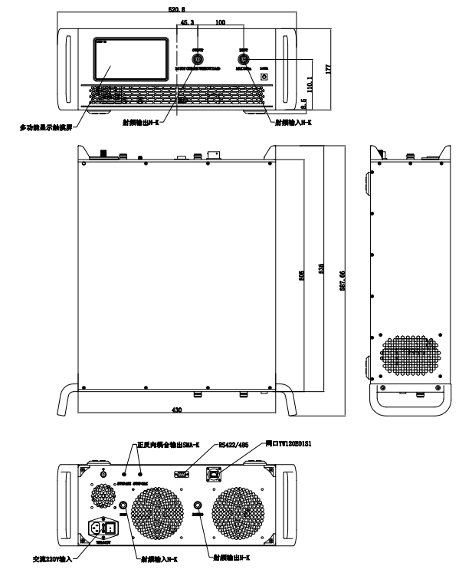
Suzhou Talent Microwave,Inc sales@talentmw.com www.talentmw.com
绝对最大值 Absolute Maximum Ratings:
参数 Parameter | 指标 Value
输入功率 RF Input Power | +10 dBm
ESD灵敏度 ESD sensitivity (HBm) | Class 0, passed 150V
外形图 Outline Drawing:
Unit:mm

Slide 3

Suzhou Talent Microwave,Inc sales@talentmw.com www.talentmw.com
主要功能 Key Features:
参数 Parameter | 特点 Advantages
控制和监控 Remote Control | Ethernet RJ-45 TCP/IP
内置保护功能 Protection functions | 1,Over TEM 2,Over voltage 3,Over current protection 4,Over VSWR
控制功能 Control functions | 1,Power setting On/Off 2,ALC On/Off
冷却系统 Cooling system | Built in Cooling system,forced air cooling
温度环境 Environmental Conditions:
参数 Parameter | Min | Typ | Max | 单位 Units
操作温度 Operating Temperature* | -20 |  | +40 | ℃
存储温度 Non-operating Temperature* | -30 |  | +50 | ℃
相对湿度 Relative humidity |  | 95 |  | %
海拔 Altitude | 10,000 |  |  | feet
震动 Shock / Vibration(MIL-STD-810F) | 25g rms (15 degree 2KHz) endurance, 1 hour per axis
冲击 Shock(non operating) | 20G for 11msc half sin wave,3 axis both directions
*Note: For a wider temperature range, please consult the manufacturer.
订货信息 Ordering Information:
标准型号 Base Number | 描述 Desciption | 版本号 Revision
TLPA18G26.5G-47-47-BC | Solid State High Power Amplifier Systems 18-26.5GHz,Gain:47dB,Psat:47dBm,220V AC,Built in Fan Cooling | Rev.1.1

